Slide 1
Claim–Support–Question (CSQ)
Year 7 English – The Bone Sparrow
Learn to make clear claims, back them with evidence, and ask probing questions by including an analysis sentence.

Slide 2
Take a Side
Rainy days are better than sunny days/ Sunny days are better than rainy days Dogs are better pets/ Cats are better pets Turn to the person next to you and tell them why you prefer this side. "Ask a question to further examine your claim."

Slide 4
What is a Claim? (C)
Think of a claim as your answer to: ‘What’s really happening here—and what does it mean?’
A claim is an arguable statement about what is going on in the text.
It can be an interpretation, generalisation, or theory (not a plot summary). Claim: The bone sparrow symbolises memory and hope. Claim: Small acts of adult kindness have big effects.

Slide 5
Good Claims VS Bad Claims
Strong | Weak
The novel builds empathy by letting the reader see detention through a child’s eyes. | The Bone Sparrow is a good book.
The story shows the specific hardships of detention that shape childhood. | Refugees have hard lives.
Friendship and stories keep hope alive when freedom is limited | Hope is important in the novel.
Good claims are specific, debatable, and focused on ideas, not just events.

Slide 6
What is Support? (S)
Support answers: ‘How do you know?’
Support is the checkable evidence that backs your claim.
Types: brief quotation, scene detail, recurring symbol/motif, pattern across chapters, consequence of a choice, contrast between characters.
Ask: Which exact words or moments carry the meaning? Is it a one‑off or a pattern?
Evidence must be relevant and precise; avoid very long quotes.

Slide 7
Support
Ask: Which exact words or moments carry the meaning? Is it a one‑off or a pattern?
Evidence must be relevant and precise; avoid very long quotes.
Support Subhi and Jimmie’s meetings and shared tales change how they face problems.

Slide 8
What is a Question? (Q)
Questions turn thinking into inquiry—not just answers.
Questions test the strength of a claim and open the next investigation.
Credibility: ‘Where might the text complicate this idea?’
Perspective: ‘Whose voice is missing? How would a different character view this?’
Criteria: ‘What evidence would convince a sceptical reader?’
Question How do friendships make brave choices possible?

Slide 9
Build an Analysis Sentence
Strong analysis sentence Fraillon shows that stories give children real power to think for themselves and choose courage, even when the gates are locked.
Use this to turn CSQ into one strong analytic sentence for a paragraph topic sentence or evidence explanation.
Template: Claim + specific Support + So‑what (effect or author message).

Slide 10
CSQ Routine – Steps
1 Identify Claims: groups write one clear claim each.
2) Identify Support: add precise evidence (quote, symbol, pattern, consequence).
3) Raise Questions: add at least one probing question per claim.
4) Share & Refine: confidence line (1–5), then tighten the wording of the claim.

Slide 11
Friendship and stories keep hope alive when freedom is limited. At the fence, Subhi and Jimmie share her mother’s book and Subhi’s “Night Sea.” These moments calm Subhi and help Jimmie understand the camp better. How do friendships make brave choices possible? They reduce fear and offer new ideas, so acting kindly feels safer. Strong analysis sentence Fraillon shows that stories give children real power to think for themselves and choose courage, even when the gates are locked.

Slide 12
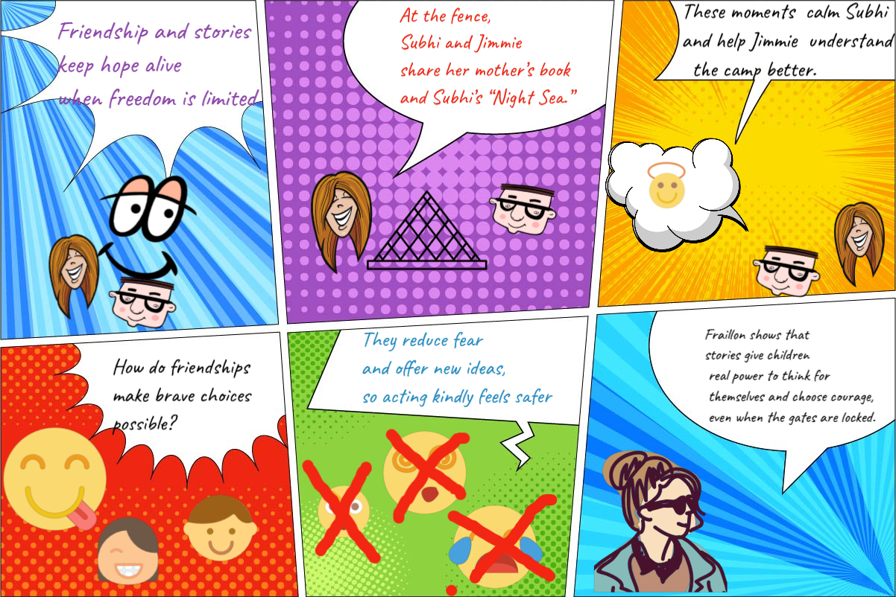

Slide 13
Our Comic
Claim: Friendship and stories keep hope alive when freedom is limited
Evidence
Question
An analysis sentence
https://lywi.com/ online comic maker

Slide 14
Creating comics (20 minutes)
Pair → Share → Refine.
Choose one scene or symbol from today’s reading.
Write a claim (C) about what it shows (use a claim code).
Add a support (S) from the relevant section. Write a question (Q) to test your claim.
Turn your CSQ into one analysis sentence using the template. https://lywi.com/ online comic maker

